Slide 1
General Principles of supportive cares in the ICU

Slide 2
Objectives
At the end of this session, you will be able to:
Recognize principles of general supportive care in the ICU
Provide general supportive care for critically ill patients in the ICU

Slide 3
Introduction
Regardless of the underlying cause of the illness,
the provision of meticulous supportive care is essential to the management of any critical ill patient.
Back in 2005, Jean Louis Vincent popularized the ‘FAST HUGS’ mnemonic
Give your patients a fast hug (at least) once a day
(Vincent JL. Crit Care Med.2005)
This was updated to ‘FAST HUGS BID’ by Vincent and Hatton (Vincent WR 3rd, Hatton KW. Crit Care Med.2009)

Slide 4
FAST-HUGS IN BED Please
Feeding/Fluid balance (therapy)
Analgesia, Antiemetics
Sedation and Spontaneous breathing trial
Thromboprophylaxis,
Head up position
Ulcer prophylaxis
Glucose monitoring
Skin/eye care and Suctioning
Indwelling catheter
Nasogastric tube
Bowel cares
Environment (e.g. temperature control, appropriate surroundings in delirium)
De-escalation of (e.g. antibiotics, end of life issue, Rx no longer needed)
Psychological support (for patient, family and staff )
(Chris Nickson, Nov.3, 2020)
Available at : https://litfl.com/fast-hugs-in-bed-please/

Slide 5
Feeding
Most pts. in ICU are too sick to sustain an adequate oral diet.
Therefore, they require enteral nutrition (EN) or parenteral nutrition (PN), or a combination
Critical illness can lead to hypermetabolic states, and
if nutritional support is inadequate or delayed, patients are at immediate risk of malnutrition.
Poor nutritional status is associated with increased mortality and morbidity.
Therefore, appropriate nutrition is an important aspect of critical care and
Adequate nutritional support should be considered a standard of care.

Slide 6
Cont…
The American College of Chest Physicians recommends that:
the daily caloric intake be based on the patient's ideal body weight
25 kcal/kg/day ((105 kJ/kg/day)) or 27.5 kcal/kg/day in the presence of SIRS in some sepsis and
trauma patients of 30 or 35 kcal/kg/day (125–146 kJ/kg/day) of which
15 to 20% should be represented by proteins (1.5 to 2 g/kg/day).

Slide 7
Cont…
Patient metabolic requirements should be established
early after ICU admission and
enteral feeding tolerance evaluated without delay (within 24 hours of admission).
Early EN initiated within 4.4 Hrs. after ICU admission resulted in
less organ dysfunction than delayed feeding (36.5 hours after ICU admission)

Slide 8
Cont…
Feeding intolerance due to high gastric residual volume can be improved by
the administration of gastric prokinetic agents, and
positioning the tube postpyloric.
Most of the trials evaluating PN do not demonstrate any favorable impact on outcome.
Evidence suggests that EN is associated with lower infection risk and
PN is associated with increased rates of complications and death.

Slide 9
Cont…
In case of EN, feeding should be started early within the first 24 - 48 hours following admission
to facilitate diet tolerance,
to reduce risk of intestinal barrier dysfunction and infections,
to reduce the length of hospital stay and mechanical ventilation.
Starting feeds at 25-50% caloric goal and increasing to 100% over 3-7 days is reasonable

Slide 10
Cont…
Complications associated with enteral feeding
Aspiration of gastric feeding
Remedy: raise the head of the patient's bed 30 to 45 degrees during feeding
Fluid and electrolyte imbalance
Diarrhea
Constipation
Abdominal distention, vomiting, and regurgitation

Slide 11
Cont…
Diarrhea is a common
potential causes
medications (antibiotics or sorbitol-containing products),
altered bacterial flora (Clostridium difficile),
formula composition (including osmolality), infusion rate,
hypoalbuminemia, bacterial contamination of the enteral fluid, and the patient's related conditions.
To prevent or reduce diarrhea, all potential etiologies should be considered and corrected.

Slide 12
Summary of Recommendations for Enteral Nutrition in Critically Ill Patients
Summary of recommendations for enteral nutrition in critically ill patients | Level of evidence
1. Enteral nutrition is associated with an improvement of nutritional variables, a lower incidence of infections and a reduced length of hospital stay. | A
2. Critically ill patients who cannot be fed orally for a period of more than three days must receive specialized nutritional support. | C
3. Enteral nutrition is preferable to parenteral nutrition. | B
4. Enteral nutrition should be started within the first 24 - 48 hours of admission. | A
5. Enteral nutrition should provide 25 to 30 kcal/kg/day. | C
6. The feedings should be advanced toward goal over the next 48 - 72 hours. | C
7. The enteral nutrition must be deferred until the patient is hemodynamically stable. | C
8. In intensive care unit patients, neither the presence nor absence of bowel sounds and evidence of passage of flatus and stool is required for initiation of enteral nutrition. | B

Slide 13
Cont…
Contraindications to EN
Absolute contraindications
gastrointestinal obstruction
prolonged paralytic ileus
enterocutaneous fistulae
Active gastrointestinal hemorrhage
Hemodynamic instability:
enteral nutrition in an ischemic small bowel can worsen the ischemia and lead to necrosis and bacterial overgrowth
Relative contraindications
Malabsorption and short bowel syndrome,
Inflammatory bowel disease,
Pancreatitis, and cholecystitis.

Slide 14
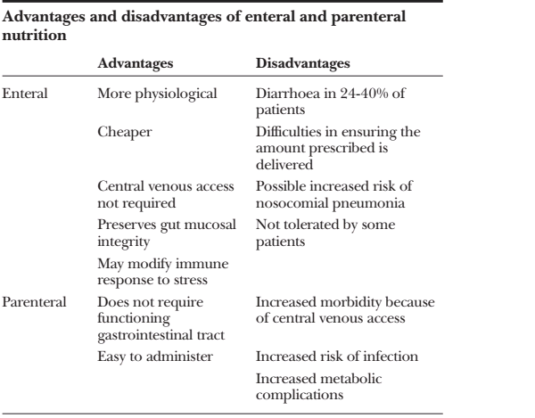

Slide 15
Analgesia and sedation of critically ill patients
Most patients in the ICU will experience some form of pain, agitation, or anxiety
The indications for sedation and analgesia in the ICU are many.
An essential goal: optimal level of analgesia and sedation
There is evidence that more than one half of patients cared for in the ICU recall unpleasant memories of their ICU stay, including
unrelieved pain,
sleep deprivation,
anxiety,
nightmares, and
hallucinations

Slide 16
Cont…
Critically ill patients are often deeply sedated, in part because of:
concerns for patient comfort,
but also because of potential benefits afforded by a reduction in the sympathoadrenal response to injury.
Additionally, complications associated with undersedation include
ventilator dyssynchrony,
patient injury,
agitation, anxiety, stress disorders and,
possibly, unplanned extubation.

Slide 17
Cont…
However, excessive sedation is also undesirable, because
it may contribute to prolonged mechanical ventilation,
increased ICU length of stay, and
increased diagnostic testing for altered mental status
Compassionate care and effective communication help patients
but drugs are often necessary to keep them comfortable.

Slide 18
Cont…
The goal of sedation and analgesia in the ICU
To effectively treat patient symptoms,
To avoid adverse effects such as
delirium,
long-term cognitive deficits, and
respiratory depression that are associated with over treatment.
The aim is for the patient to be comfortable at all times!!!

Slide 19
Cont.…
Ventilated patients generally require sedation
to tolerate both ventilation and
the presence of an endotracheal tube.
The patient with an ideal level of sedation and analgesia is at reduced risk for
dislodging catheters,
removing monitoring devices, or
falling out of bed.

Slide 20
Cont…
Indications for analgesia and sedation
Allow effective ventilation
Reduce oxygen demand
Provide analgesia
Reduce anxiety
Relieve distress
Facilitate sleep
Provide amnesia
Reduce depression

Slide 21
Cont…
Confusion and agitation are common in ICU patients and could have unfavorable consequences on patient outcome.
Patients experiencing agitation have been reported to have
a higher incidence of major complications,
higher admission to rehabilitation centers, and
increase duration of hospital stay.
Agitation is also a predictive factor for mortality.
Agitation needs to be distinguished from delirium,
which is relatively common in ICU patients and equally associated with increased length of stay, morbidity, and mortality.

Slide 22
Cont…
Agitation: it is a psychomotor disturbance characterized by:
a marked increase in both motor and psychological activities;
a loss of control of action and disorganization of thoughts
Delirium: it is a state of acute confusion.
It is acute change in mental status or fluctuation of mood
Delirium is associated with
impaired attention,
disorganized thinking,
confusion and altered level of consciousness.

Slide 23
Cont…
Delirium can be difficult to diagnose in ICU patients
as features of delirium, such as altered status of consciousness, are shared with several disorders typical of ICU patients.
The distinguishing characteristics of delirium include
acute onset and fluctuating course,
inattention,
disorganized thinking, and
altered level of consciousness.
An ICU delirium diagnostic scale (CAM-ICU scale) has been proposed and is a valid instrument to diagnose delirium in the ICU.
Notes:
CAM-ICU –confusion assessment method for the ICU

Slide 24
Cont…
Non pharmacologic and pharmacologic means can be used to provide comfort and safety to ICU patients.
Non pharmacologic means include
communication, frequent reorientation,
maintenance of a day-night cycle,
noise reduction, and ensuring ventilation synchrony.
The first-line interventions should be non-pharmacologic
Pharmacologic agents include
hypnotics-anxiolytics, opioids, and antipsychotics
Hypnotics most commonly used are propofol, midazolam, and lorazepam.
Each of these drugs has its own particular advantages and disadvantages

Slide 25
Cont…
Sedation doses
Propofol for sedation
25–75 µg/kg/min IV drip
Midazolam
0.01-0.1 mg/kg IV
Lorazepam
0.03-0.04 mg/kg IV

Slide 26
Cont…
A prospective, randomized, non-blinded trial compared a continuous infusion of lorazepam, midazolam, and propofol in trauma patients.
Midazolam appeared to be the most titratable drug, with the lowest incidence of over- and undersedation.
Lorazepam was the most cost-effective choice for sedation
despite the observation that oversedation occurred twice as often with lorazepam than with propofol or midazolam.

Slide 27
Cont…
A meta-analysis including 27 randomized trials comparing propofol versus midazolam suggested that
tracheal extubation occurred earlier with the use of propofol for patients who were ventilated for a duration of shorter than 36 hours.
However, no differences were found with regard to the ICU length of stay or mortality.
Greater levels of hypotension and elevated triglyceride levels were observed with the use of propofol.
Since then, an open label randomized trial found that continuous infusion of propofol was associated with
shorter length of mechanical ventilation and ICU stay compared with intermittent lorazepam administration.

Slide 28
Cont…
Propofol infusion syndrome is a rare, but lethal syndrome associated with
infusion of propofol at 5 mg/kg/hr or greater for 48 hours or longer.
It was first described in children but has also subsequently been observed in critically ill adults.
Clinical features include
cardiomyopathy with acute cardiac failure,
metabolic acidosis, skeletal myopathy, hyperkalemia, hepatomegaly, and lipemia.
Present evidence suggests that this syndrome occurs as a result of
failure of free fatty acid metabolism because of inhibition of free fatty acid entry into mitochondria and failure of the mitochondrial respiratory chain

Slide 29
Cont…
Dexmedetomidine, a unique sedative agent that is an α₂-adrenergic receptor agonist,
provides sedation without inducing coma,
has some analgesic effect, and
has little effect on respiratory drive.
Dexmedetomidine has been effectively used as a single agent or in combination with other drugs in ICU patients.
However, dexmedetomidine is costly,
it is currently approved by the Food and Drug Administration for use for only up to 24 hours, and
there is insufficient evidence to recommend its routine use at the current time

Slide 30
Cont…
Opiates are a common component of many ICU analgesia and sedation regimens
They are used as single agents in certain types of patients
e.g., pts. with acute postoperative pain, with uncomplicated respiratory failure requiring modest degrees of mechanical ventilation, or
who require sedation but do not tolerate hypnotic-anxiolytic drugs.

Slide 31
Cont.…
Like dexmedetomidine, opiates do not reliably produce amnesia, and are not appropriate as single agents in patients who require paralysis.
Morphine and fentanyl are the most commonly used opioids to provide analgesia in the ICU.
Morphine should be avoided in patients with renal failure
due to active metabolites that accumulate in the presence of impaired renal function

Slide 32
Cont…
Delirium in the ICU is commonly treated with antipsychotic agents such as haloperidol, olanzapine, quetiapine, and risperidone.
However, none of these agents has been proven effective for the treatment of ICU-associated delirium in a randomized, placebo-controlled trial, and
It is not clear that the newer agents, although more expensive, are more effective than haloperidol.

Slide 33
Cont…
Neuromuscular blockade may be occasionally indicated in ICU patients with severe TBI or respiratory failure,
But routine use is discouraged because of concerns of
critical illness polyneuropathy and
increased risk of nosocomial pneumonia in patients receiving these agents.

Slide 34
Cont…
Agitation Sedation Scoring Scales
Titrating sedatives and analgesics to a specific behavioral target allows optimization of dosing.
Several validated and reliable scoring scales have been developed to improve the delivery of sedation.
The most frequently used scoring systems include
Ramsay Sedation Scale (RSS),
Richmond Agitation Sedation Scale (RASS)
Riker Sedation-Agitation Scale (SAS), and WELL VALIDATED
Motor-Activity Assessment Scale (MAAS).
Common features to all scales are the grading of sedation over different depths and allowance for indicators of agitation.

Slide 35
Cont…
The Ramsay Sedation scale
It is developed in 1974
It is a 6-point system ranging from
1- for anxious to
6- for unarousable.
It unfortunately lacks behavioral descriptors
Nevertheless, this is one of the most widely used and validated scales.

Slide 36
Ramsay Sedation Scale Score Response 1 Anxious and agitated or restless, or both 2 Cooperative, oriented, and tranquil 3 Responding to commands only 4 Brisk response to light glabellar tap 5 Sluggish response to light glabellar tap 6 No response to light glabellar tap

Slide 37
Cont…
Richmond Agitation Sedation Scale (RASS)
Score | Term | Description | Stimulation
+4 | Combative | Overtly combative, violent, immediate danger to staff
+3 | Very agitated | Pulls or removes tube(s) or catheter(s); aggressive
+2 | Agitated | Frequent non-purposeful movement, fights ventilator
+1 | Restless | Anxious but movements not aggressive vigorous
0 | Alert and calm
-1 | Drowsy | Not fully alert, but has sustained awakening (eye-opening/eye contact) to voice (≥10 seconds) | Verbal Stimulation
-2 | Light sedation | Briefly awakens with eye contact to voice (<10 seconds) | Verbal Stimulation
-3 | Moderate sedation | Movement or eye opening to voice (but no eye contact) | Verbal Stimulation
-4 | Deep sedation | No response to voice, buy movement or eye opening to physical stimulation | Physical Stimulation
-5 | Unarousable | No response to voice or physical stimulation | Physical Stimulation
From : Handbook of Mechanical Ventilation. Care of the ventilated patient . 2015; 117
Notes:
Ideally, sedation should result in a patient who is either awake but co-operative or who is lightly sedated but responding to commands (i.e. a score 0 to -2).

Slide 38
Cont…
The Riker SAS
It was developed in 1994 and then revised in 1999.
It provides a symmetric approach to grading patient behavior with
three severity levels each for sedation and agitation and
one level for the calm patient.
Behavioral descriptors provide clinicians assistance with assigning scores.

Slide 39
Cont…
Sedation-Agitation Scale
Score | Response
7 | Dangerous agitation. Patient pulls at endotracheal tube, thrashes, climbs over bed rails.
6 | Very agitated. Patient does not calm, requires restraints, bites endotracheal tube.
5 | Agitated. Patient attempts to sit up but calms to verbal instructions.
4 | Calm and cooperative. Patient follows commands.
3 | Sedated. Patient is difficult to arouse but follows simple commands.
2 | Very sedated. Patient arouses to stimuli but does not follow commands.
1 | Unarousable. Patient has minimal or no response to noxious stimuli.

Slide 40
Cont…
The Motor Activity Assessment Scale (MAAS)
It was reported in 1999 and is similar to the SAS.
It also has three categories for sedation and agitation and a middle level for calm and cooperative.
The behavioral descriptors are similar to the SAS, but the scoring starts from 0 instead of 1.

Slide 41
Motor Activity Assessment Scale
Score | response
6 | Dangerously agitated, uncooperative. No external stimulus is required to elicit movement, and pt. pulls at tubes or catheters, thrashes side to side or strikes at staff, tried to climb out of bed, and does not calm down when asked
5 | Agitated. No external stimulus is required to elicit movement, and an pt. attempts to sit up or moves limbs out of bed and does not consistently follow commands (e.g., lies down when asked but soon reverts to attempts to sit up and move limbs out of bed).
4 | Restless and cooperative. No external stimulus is required to elicit movement, and patient picks at sheets or tubes or uncovers self and follows commands.
3 | Calm and cooperative. No external stimulus is required to elicit movement, and patient adjusts sheets or clothes purposefully and follows commands.
2 | Responsive to touch or name. Patient opens eyes, raises eyebrows, or turns head toward stimulus or moves limbs when touched or name is loudly spoken.
1 | Responsive only to noxious stimuli. Patient opens eyes, raises eyebrows, or turns head toward stimulus or moves limbs in response to noxious stimulus (e.g., suctioning; 5 seconds of vigorous orbital, sternal, or nailbed pressure).
0 | Unresponsive. Patient does not move with noxious stimulus (e.g., suctioning, 5 seconds of vigorous orbital, sternal, or nailbed pressure).

Slide 42
Cont…
In summary, sedation and analgesia should be provided in the ICU population to ensure patient comfort and safety.
In establishing treatment algorithms, analgesia should be prioritized over sedation.
Titration and assessment of analgesia and sedation should be an integral part of ICU monitoring so that over- and undersedation can be avoided.

Slide 43
Thromboprophylaxis
VTE prophylaxis
It is generally agreed that high-risk patients without contraindications should receive prophylaxis with LMWH, and
patients with low-to-moderate risk should receive low-dose UFH .
Patients with contraindications to LMWH or UFH should probably receive prophylaxis with mechanical devices (serial compression devices),
although there is no compelling evidence to suggest that they are effective in the ICU population
Prophylaxis anticoagulant
Low molecular weight heparin, 5000 IU
Enoxaparin 40 mg SC

Slide 44
Cont…
The mainstay of treatment for VTE is heparin,
which should be started prior to confirmatory studies if clinical suspicion is high.
LMWH may be superior to UFH in efficacy with comparable rates of bleeding for the treatment of VTE
the choice of drug should be based on clinical circumstances and availability.
The advantage of UFH in the ICU population is
its titratability and rapid reversibility, which may be desirable in patients at high risk for bleeding

Slide 45
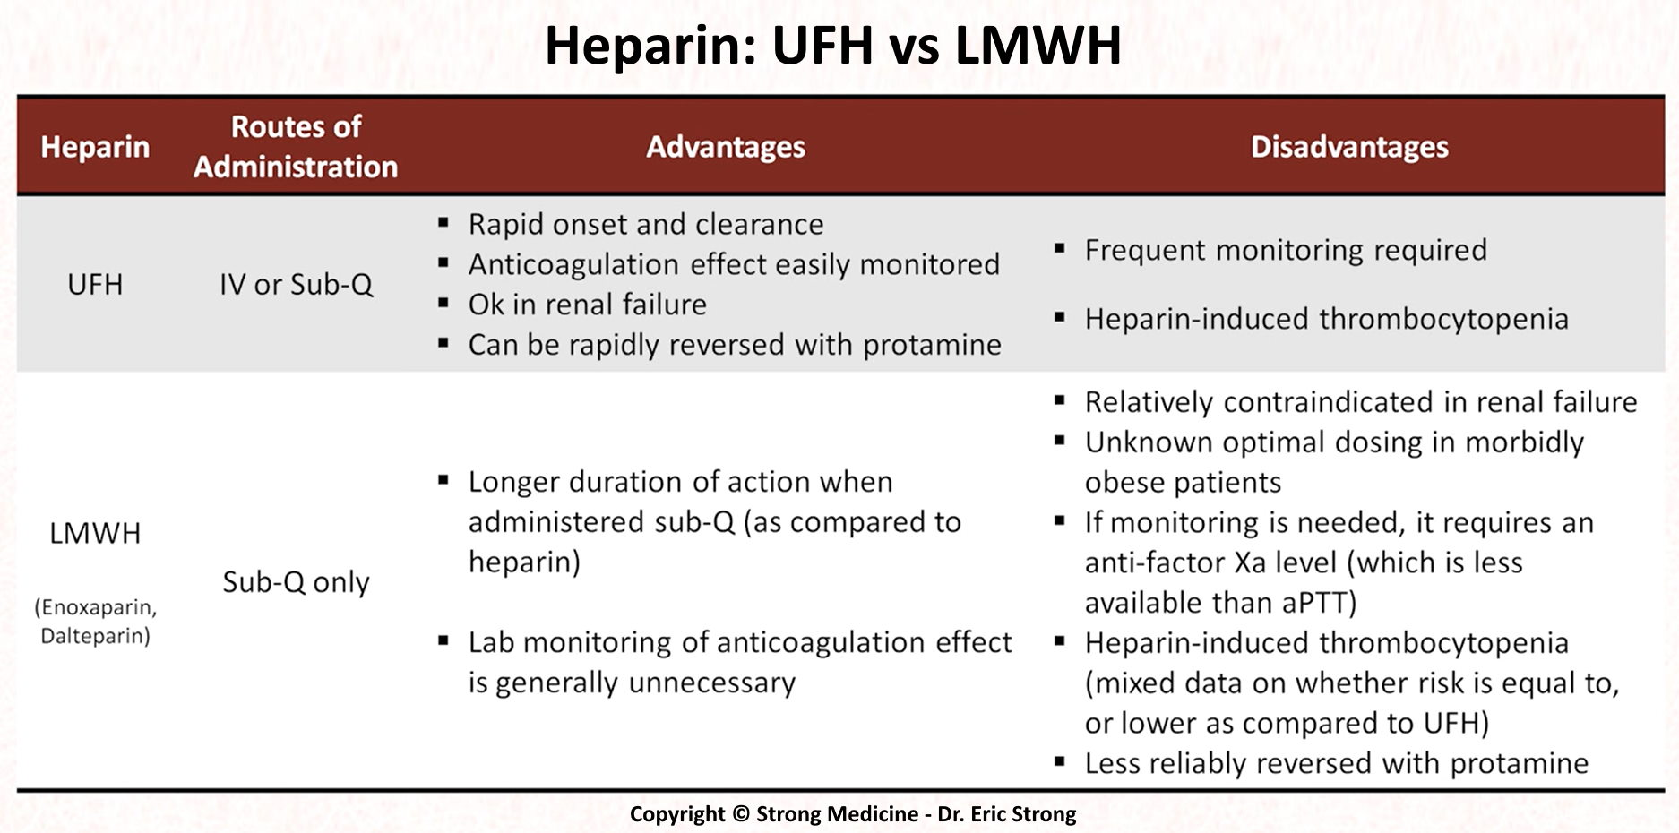
Cont…

Slide 46
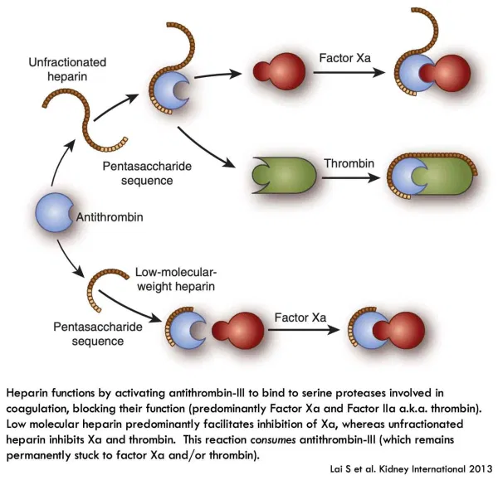
Cont…

Slide 47
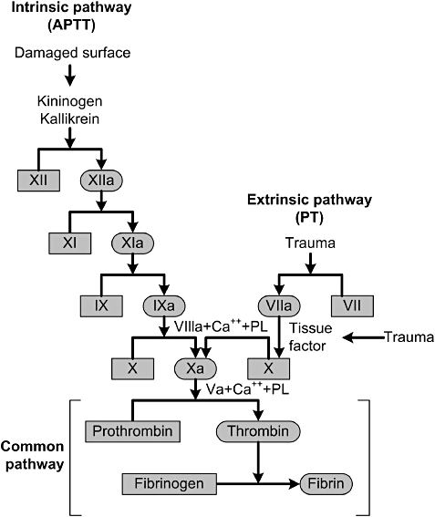
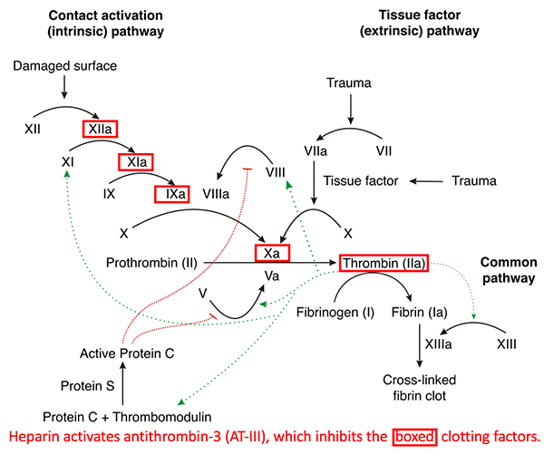
Coagulation cascade

Slide 48
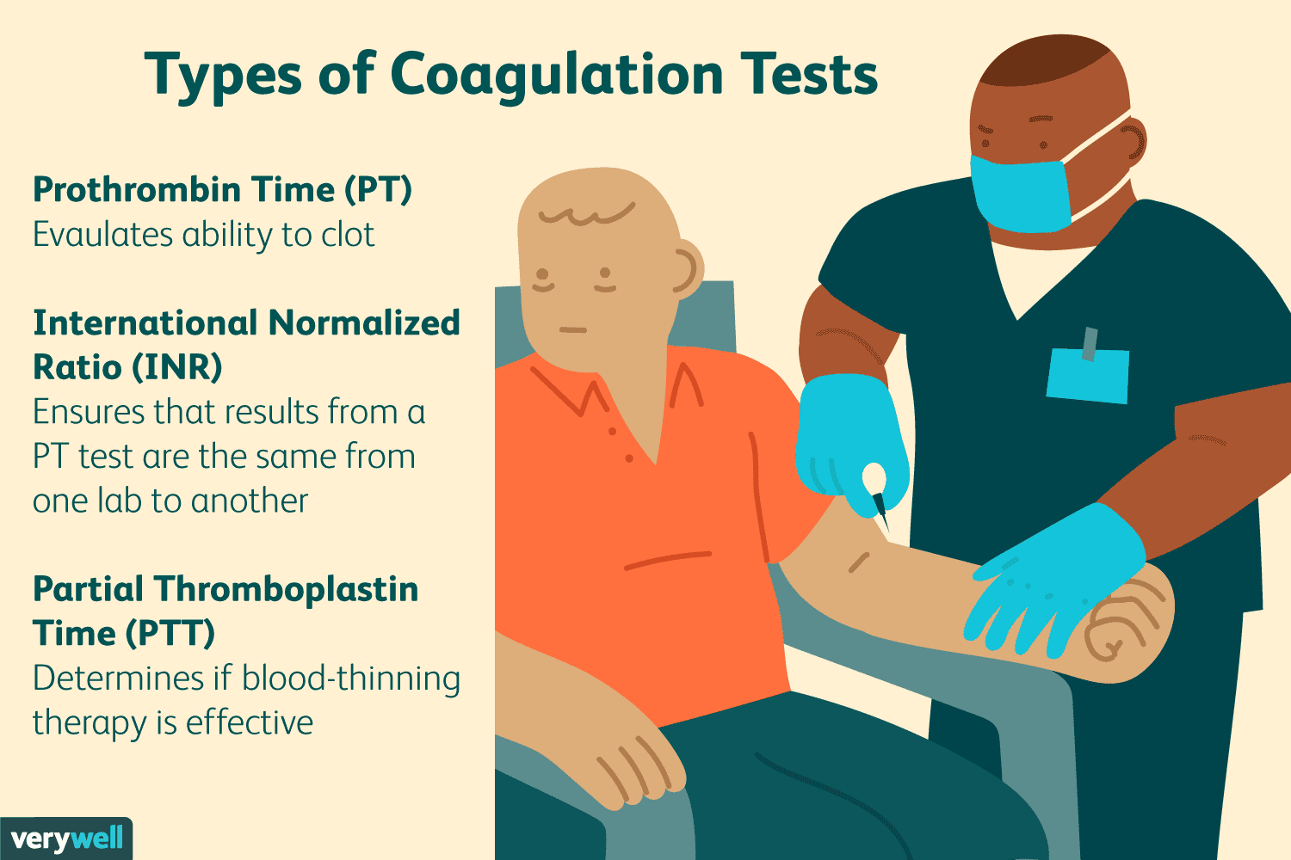
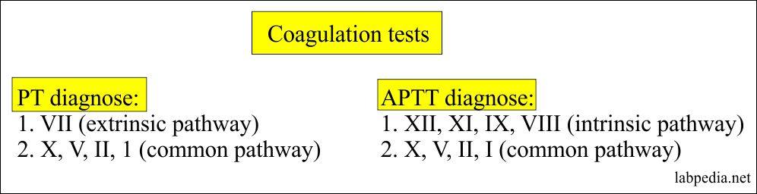
Cont…

Slide 49
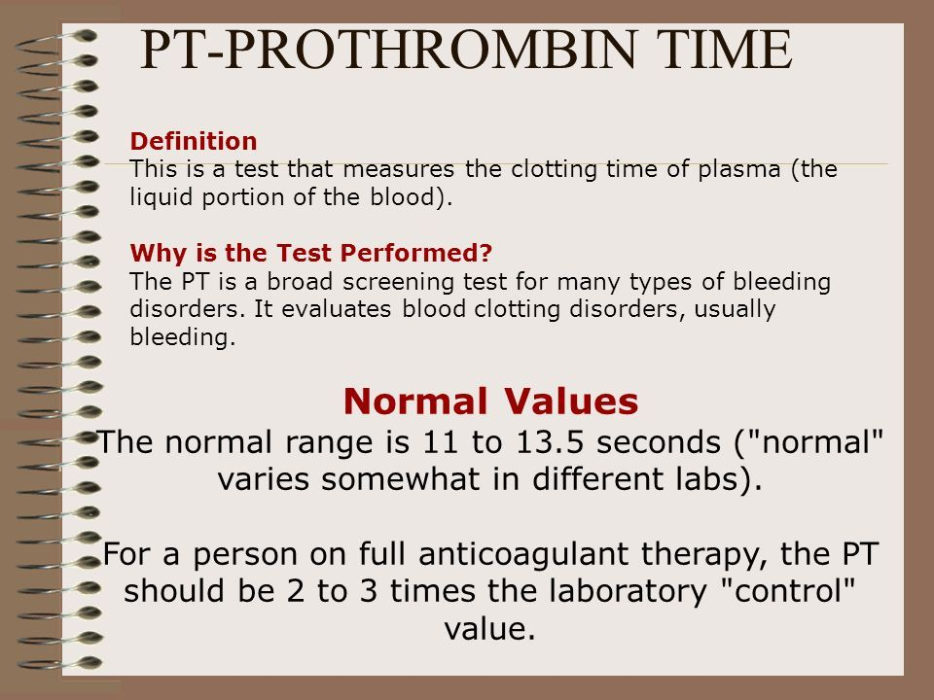
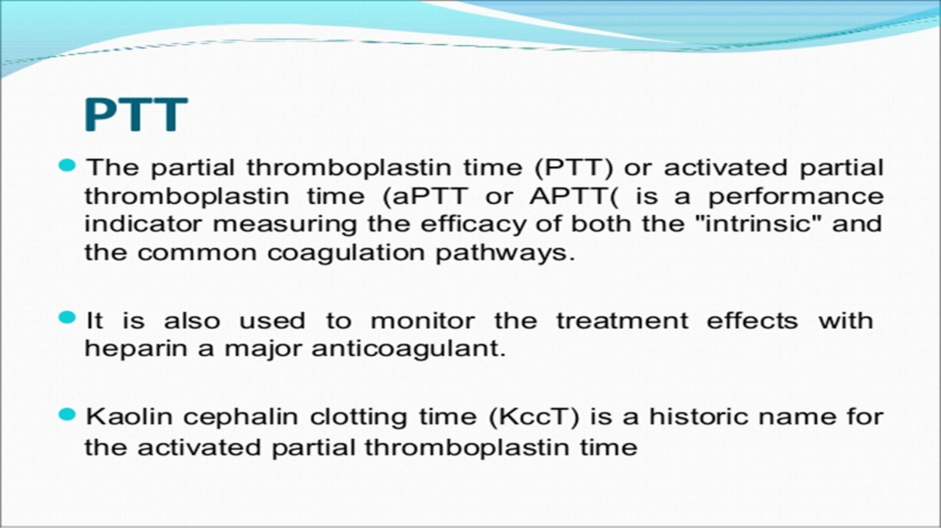
Cont…

Slide 50
Ulcer prophylaxis
Ventilated patients are at risk of gastric and duodenal stress ulceration although rates of bleeding are very low nowadays (<0.5%).
Prevention
ensuring adequate tissue perfusion (i.e. blood flow/fluid resuscitation) and
Enteral nutrition – which encourages mucosal perfusion

Slide 51
Ulcer prophylaxis…
Agents used to prevent stress ulceration and GI bleeding include:
methods to suppress acid production
H₂ blockers
proton pump inhibitors
cytoprotective agents (sucralfate)

Slide 52
Position
Regular turning to avoid pressure sores helps mobilise and clear secretions.
Patients who are too unstable to be turned regularly may benefit from being nursed on special beds that allow some degree of rotation.
Semi-recumbent positioning of the patient (head height at 30-45 degrees or greater from horizontal).
This position results in decreased gastroesophageal reflux
Pts with resistant hypoxemia may benefit from being turned prone.
The improved oxygenation probably results from normalisation of pleural pressure gradients within the lung.

Slide 53
Glucose Management in Critical Illness
Hyperglycemia is commonly encountered in critically ill patients, and occurs in both diabetics and nondiabetics.
Possible causes
increased glucose production,
depressed glycogenesis and
insulin resistance
caused by inflammatory and hormonal mediators that are released in response to injury.
It may also be aggravated by various therapeutic and supportive interventions,
including the use of corticosteroids and total parenteral nutrition.

Slide 54
Cont…
It is associated with
increased risk of postoperative infection and
poor outcome in patients with stroke or TBI
In addition, the blood glucose level is a risk factor for mortality in diabetic patients admitted with acute myocardial infarction.

Slide 55
Cont.…
Managing glucose levels in critically ill patients is a delicate balancing act.
For years, the medical community swung between aggressive tight control and more relaxed targets.
Today, the focus is on avoiding the "deadly triad":
hyperglycemia, hypoglycemia, and high glycemic variability

Slide 56
The current clinical consensus, major trial data, and management strategies for glucose control in the ICU
1. The Target: What is the "Sweet Spot"?
Current international guidelines (ADA & SCCM) recommendation for most critically ill adults:
Trigger for Insulin Therapy: Initiate treatment when blood glucose levels are persistently ≥ 180 mg/dL (10.0 mmol/L).
Target Range: Once insulin is started, maintain blood glucose between 140–180 mg/dL (7.8–10.0 mmol/L).
Strict (conventional) vs. Liberal: A lower target (e.g., 110–140 mg/dL) may be acceptable for select patients (like post-cardiac surgery) only if it can be achieved without causing significant hypoglycemia.
Targets below 110 mg/dL are universally discouraged.
Notes:
A sweet spot is the ideal set of conditions, a specific location, or a perfect balance of factors that produces the best possible outcome.

Slide 57
Cont.…
Why the Shift?
The Landmark Trials: The evolution of glucose management in the ICU is defined by two major eras of clinical trial data:
The Leuven Trials (Early 2000s)
The Idea: Intensive insulin therapy targeting tight euglycemia (80–110 mg/dL).
The Finding: Initial single-center studies showed a dramatic reduction in mortality and morbidity (e.g., sepsis, renal failure).
The Catch (Problem): These results proved difficult to replicate globally and carried a massive risk of severe hypoglycemia.

Slide 58
Cont.…
The NICE-SUGAR Trial (2009)
The Idea: A massive, multi-center international RCT comparing intensive control (81–108 mg/dL) to conventional control (Strict Glycemic Control ) (< 180 mg/dL).
The Finding: Intensive glucose control increased 90-day mortality and significantly increased the risk of severe hypoglycemia (≤ 40 mg/dL).
The Legacy: This trial fundamentally shifted global guidelines to the more moderate 140–180 mg/dL target used today.
Notes:
The NICE-SUGAR trial (Normoglycemia in Intensive Care Evaluation and Survival Using Glucose Algorithm Regulation) remains one of the most influential multi-center studies in critical care history. Published in the New England Journal of Medicine in 2009, it fundamentally reversed a decade of clinical practice regarding blood sugar targets in the ICU.

Slide 59
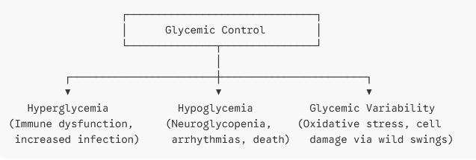
Cont.…
3. The Three Pillars of Glycemic Harm
When managing a patient, clinicians must guard against three distinct phenomena:

Slide 60
Cont.…
1. Stress Hyperglycemia
Even patients without pre-existing diabetes can develop high blood sugar in the ICU due to the surge of counter-regulatory hormones (cortisol, epinephrine) and pro-inflammatory cytokines.
This causes insulin resistance and increased hepatic glucose production.
Left unchecked, it impairs immune function and increases infection rates.
2. Hypoglycemia (The Immediate Danger)
Severe hypoglycemia (< 40 mg/dL) is an independent predictor of ICU mortality.
It causes neuroglycopenia, cardiac arrhythmias, and can permanently damage neurological tissue.
The risk increases with continuous insulin infusions, making rigorous monitoring mandatory.
3. Glycemic Variability
Rapid fluctuations between high and low glucose levels cause more oxidative stress and endothelial damage than a stable, slightly elevated blood glucose level. Stability is key.

Slide 61
Cont.…
4. Best Practices for Clinical Implementation
To manage these targets safely, ICU protocols typically rely on a structured approach:
Continuous Intravenous Insulin:
IV insulin is preferred over SC insulin for critically ill patients due to unpredictable perfusion and erratic absorption in shocked or edematous states.
IV infusions allow for rapid titration.
Frequent Monitoring
Blood glucose should be checked every 1 to 2 hours until the insulin infusion rate and blood glucose levels are stable, and then every 4 hours thereafter.

Slide 62
4. Best Practices for Clinical Implementation…..
Accurate Sampling
Arterial or venous blood gas samples analyzed via laboratory or point-of-care (POC) analyzers are more accurate than fingerstick capillary blood gas testing,
especially in patients who are hypotensive, on vasopressors, or severely edematous.
The Diabetes Nuance
Patients with long-standing, poorly controlled diabetes (high HbA1c) may tolerate slightly higher glucose ranges better than patients without diabetes,
as their bodies are adapted to chronic hyperglycemia.
Chronic hyperglycemia patients may suffer cellular distress if dropped too quickly into a "normal" range.
Notes:
Diabetic nuance refers to the subtle, individualized, and complex factors that influence blood sugar control. It highlights that diabetes management is never a simple, one-size-fits-all formula, but rather requires paying attention to the unique daily details of a person's life

Slide 63
Cont…
Strict Glycemic Control (conventional therapy )
It has been advocated as leading to multiple outcome benefits in critically ill patients.
Traditionally, hyperglycemia from sepsis was viewed as a beneficial response because??
it promoted cellular glucose uptake when cells were energy deprived.
A glucose concentration of
160 to 200 mg/dl was commonly recommended and
was thought to maximize cellular glucose uptake without causing hyperosmolarity.
However, neutrophil function is impaired in patients with hyperglycemia because of decreased bacterial phagocytosis.

Slide 64
Cont…
Hyperglycemia in diabetics is associated with an increased rate of postoperative infections.
Hyperglycemia is also associated with a poorer prognosis after stroke or head injury.
Better glycemic control (blood glucose <215 mg/dL) in diabetics with myocardial infarction has been shown to improve long-term outcome in several studies.

Slide 65
Other
Physiotherapy
Patients who are intubated cannot clear secretions effectively because of
reduced consciousness level, poor cough effort, and discomfort.
Regular chest physiotherapy and tracheal suction are essential.
Aim of chest physiotherapy is
to remove excess bronchial secretions,
re-expand atelectatic areas,
improve ventilation,
decrease ventilation-perfusion mismatch, and
mobilise the thoracic cage

Slide 66
Cont…
The primary aims of chest physiotherapy are
to improve gas exchange and
prevent atelectasis and consolidation, which occur as a result of mucus plugging or infection.
Patients are assessed daily and will receive the following treatments as appropriate.
Positioning—for postural drainage or to improve V/Q matching.

Slide 67
Cont…
Manual hyperinflation: A 2-liter manual inflation bag is used to deliver up to 1.5X the patients TV.
An inspired breath is delivered at a slow rate and held for a short period before releasing rapidly. Normal saline can be instilled before the breath.
This technique reinflates atelectatic areas of lung and loosens secretions by improving collateral ventilation.
This improves arterial oxygenation and lung compliance.

Slide 68
Cont…
Manual techniques—Shaking and vibrations applied to the chest wall may loosen secretions in the airways.
Suction—Secretions are removed by applying 25-30 kPa of negative pressure through a catheter passed down the endotracheal tube to the level of the carina.

Slide 69
Cont…
Mobilisation
Eye and mouth care

Slide 70
References
https://litfl.com/fast-hugs-in-bed-please
Maire P Shelly, Peter Nightingale . ABC of intensive care: Respiratory support . BMJ. 19 JUNE 1999 ,VOLUME 318; 1674-77.www.bmj.com.

Slide 71
THANK YOU
THANK YOU

